Slide 1
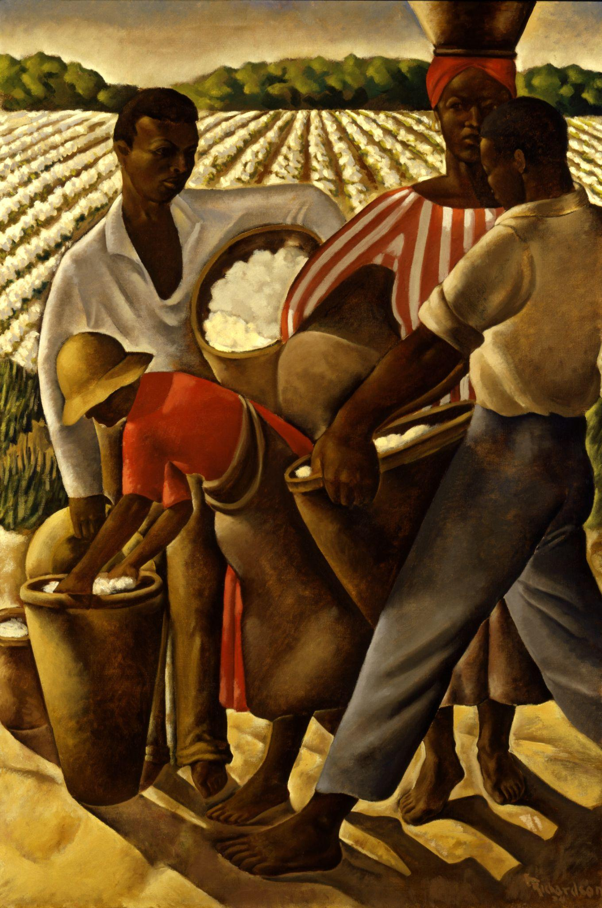

Push, Pull, and Perseverance
The Great Migration Experience

Slide 2
See, Think, Wonder
Notes:
DIRECTIONS
Look at the image on the slide. — Each slide is ¼ of a full image.
Use your graphic organizer to analyze the image to discover more about it.
SEE: What do you see or observe?
THINK: What inferences can you make?
WONDER: What questions do you have?

Slide 3
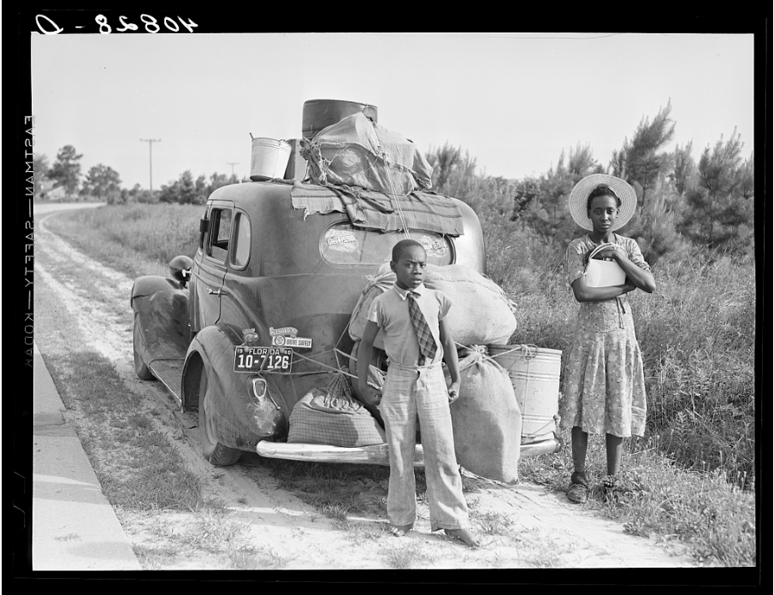
Image 1
See?
What do you see or observe?
Think?
What inferences can you make?
Wonder?
What questions come to mind?

Slide 4
Image 2
See?
What do you see or observe?
Think?
What inferences can you make?
Wonder?
What questions come to mind?

Slide 5
Image 3
See?
What do you see or observe?
Think?
What inferences can you make?
Wonder?
What questions come to mind?

Slide 6
Image 4
See?
What do you see or observe?
Think?
What inferences can you make?
Wonder?
What questions come to mind?

Slide 7
QUESTIONS?
Notes:
Allow students to share some of their “WONDER” questions.

Slide 8
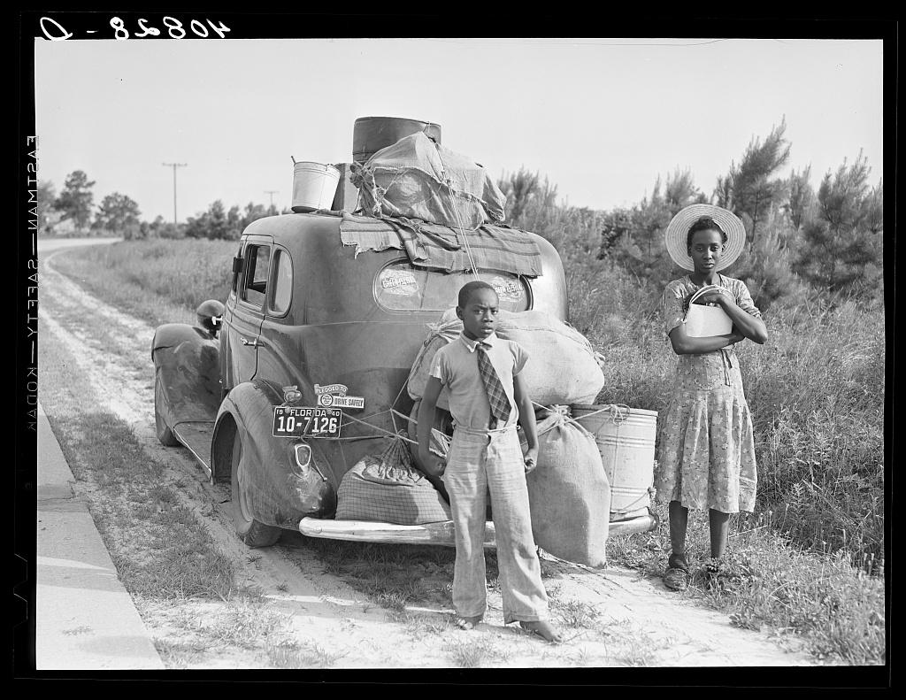
The Full Picture
Notes:
(Photo Description below.) Ask students if there is anything in the full picture that they missed by only looking at the individual sections.
The photograph is of a group of people migrating from Florida to Cranberry, New Jersey to pick potatoes during the Great Migration. This was a significant event in American history that took place during the early 20th century. It involved the movement and migration of millions of African Americans from the rural South to urban areas in the North, Midwest, and West of the United States. The migration had a huge impact on American culture, influencing music, literature, art, and politics.

Slide 9
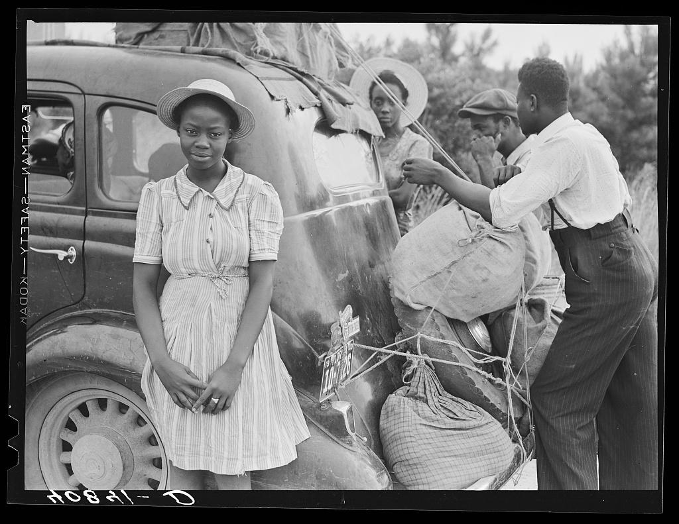
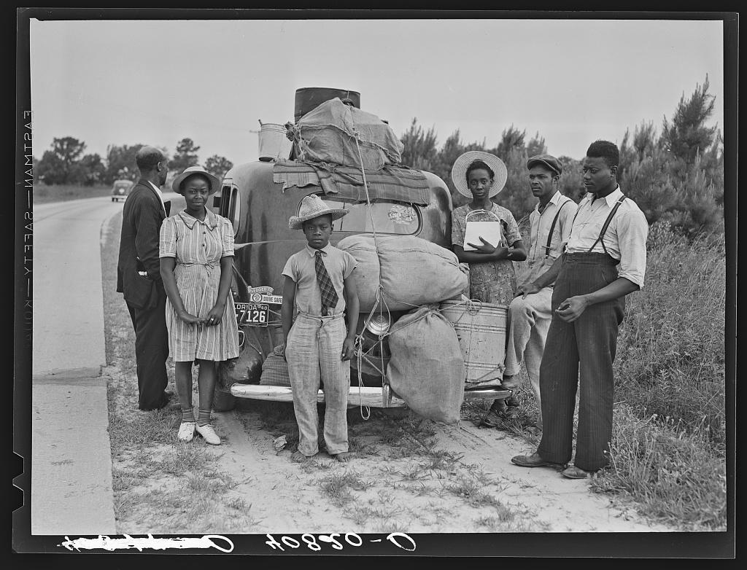
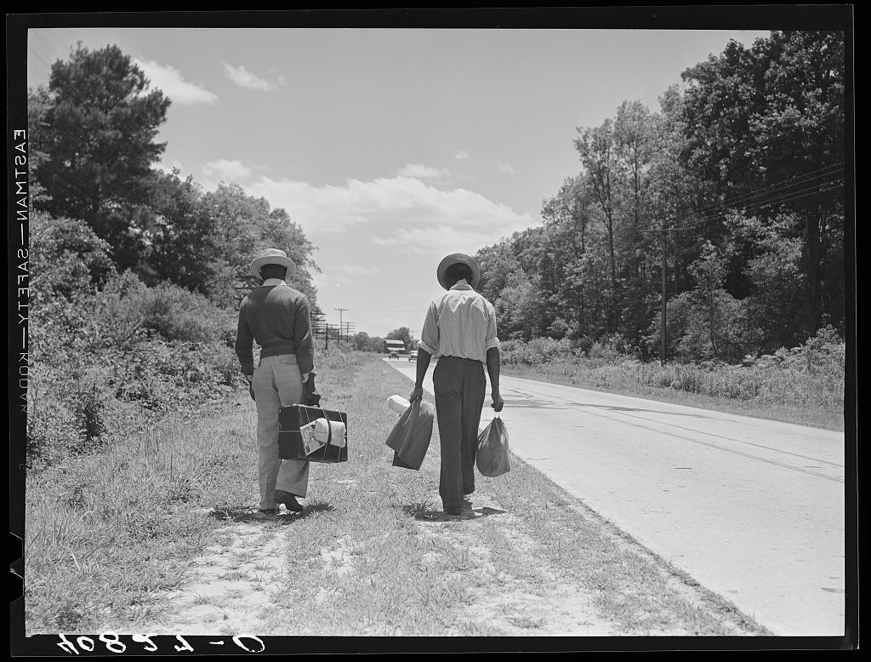
Another Perspective
Notes:
Can we gather additional information from seeing the same event, place, group, or person from another perspective?
From Left: A full family photo featuring more members of the family from the original picture; another photo of the same family but with a different focus; other agricultural laborers with no car set out to hitch hike.

Slide 10
What Do You Know?
The Great Migration
Notes:
Ask students what they know about the Great Migration? (write or display on the board)

Slide 11
What motivates people to migrate?
Notes:
Introduce students to the essential question of the lesson: What motivates people to migrate? How do these images relate to this question?

Slide 12
Intro Video
Notes:
Provide students with a copy of Worksheet 2: Cause and Effect Graphic Organizer and instruct students to use it to take notes while watching “High School US History: The Great Migration” and during the discussion after the video.

Slide 13


Slide 14
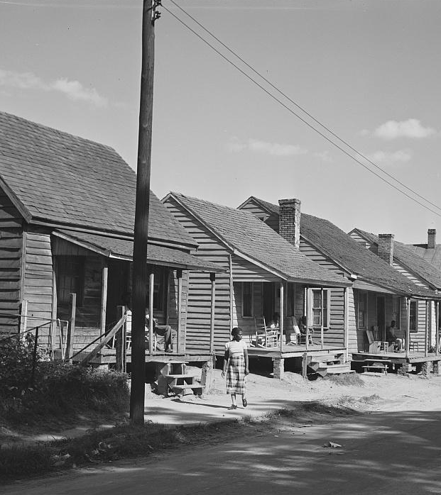
Push factors?
Notes:
1.What were some of the push factors that motivated African Americans to leave the rural South during the Great Migration? How did racial discrimination, economic challenges, and Jim Crow laws contribute to these push factors?

Slide 15
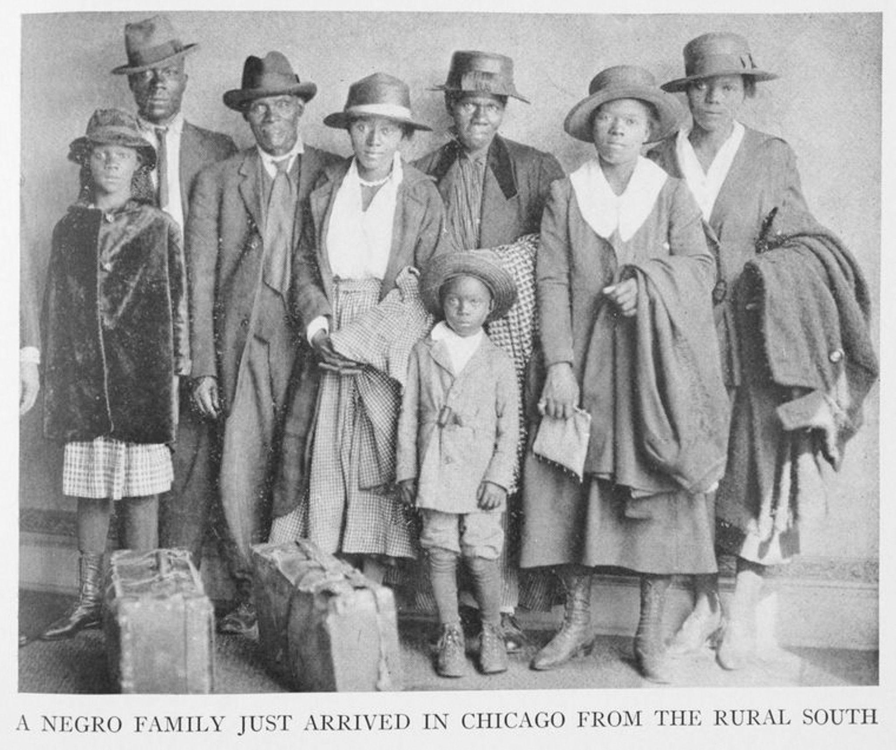
Pull factors?
Notes:
2.What were the pull factors that attracted African Americans to the northern cities during the Great Migration? How did the promise of better job opportunities, improved living conditions, and reduced racial segregation influence their decisions?

Slide 16
Notes:
If a physical Gallery Walk is not possible, please use the following digital version.
.

Slide 17
Gallery Walk
Notes:
.

Slide 18
Directions
Your group has two minutes at each stop to:
  Observe the image
  Discuss details
  Respond to the posted question on the provided note takers.
Make note of any questions or observations you want to discuss.

Slide 19
Exhibit 1
Notes:
· What is this item?
· Why do you think this item was created?
· What group, event, or issue is represented in this item?

Slide 20
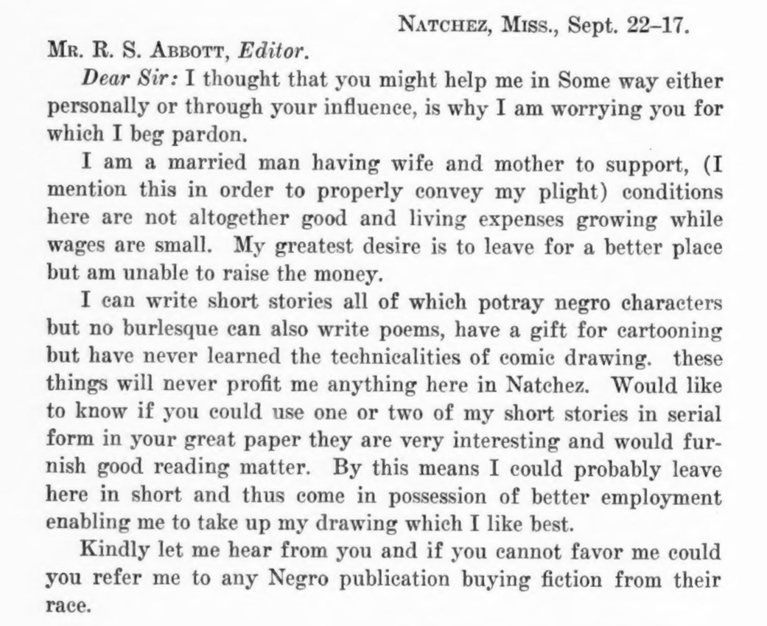
Exhibit 2
Notes:
Letter to the editor of the Chicago Defender from a man hoping to find work in Chicago.
· What is this item?
· What event or issue does this item represent?
· Describe this item in four words. Now, explain what you want people to infer about this image from those four words.

Slide 21
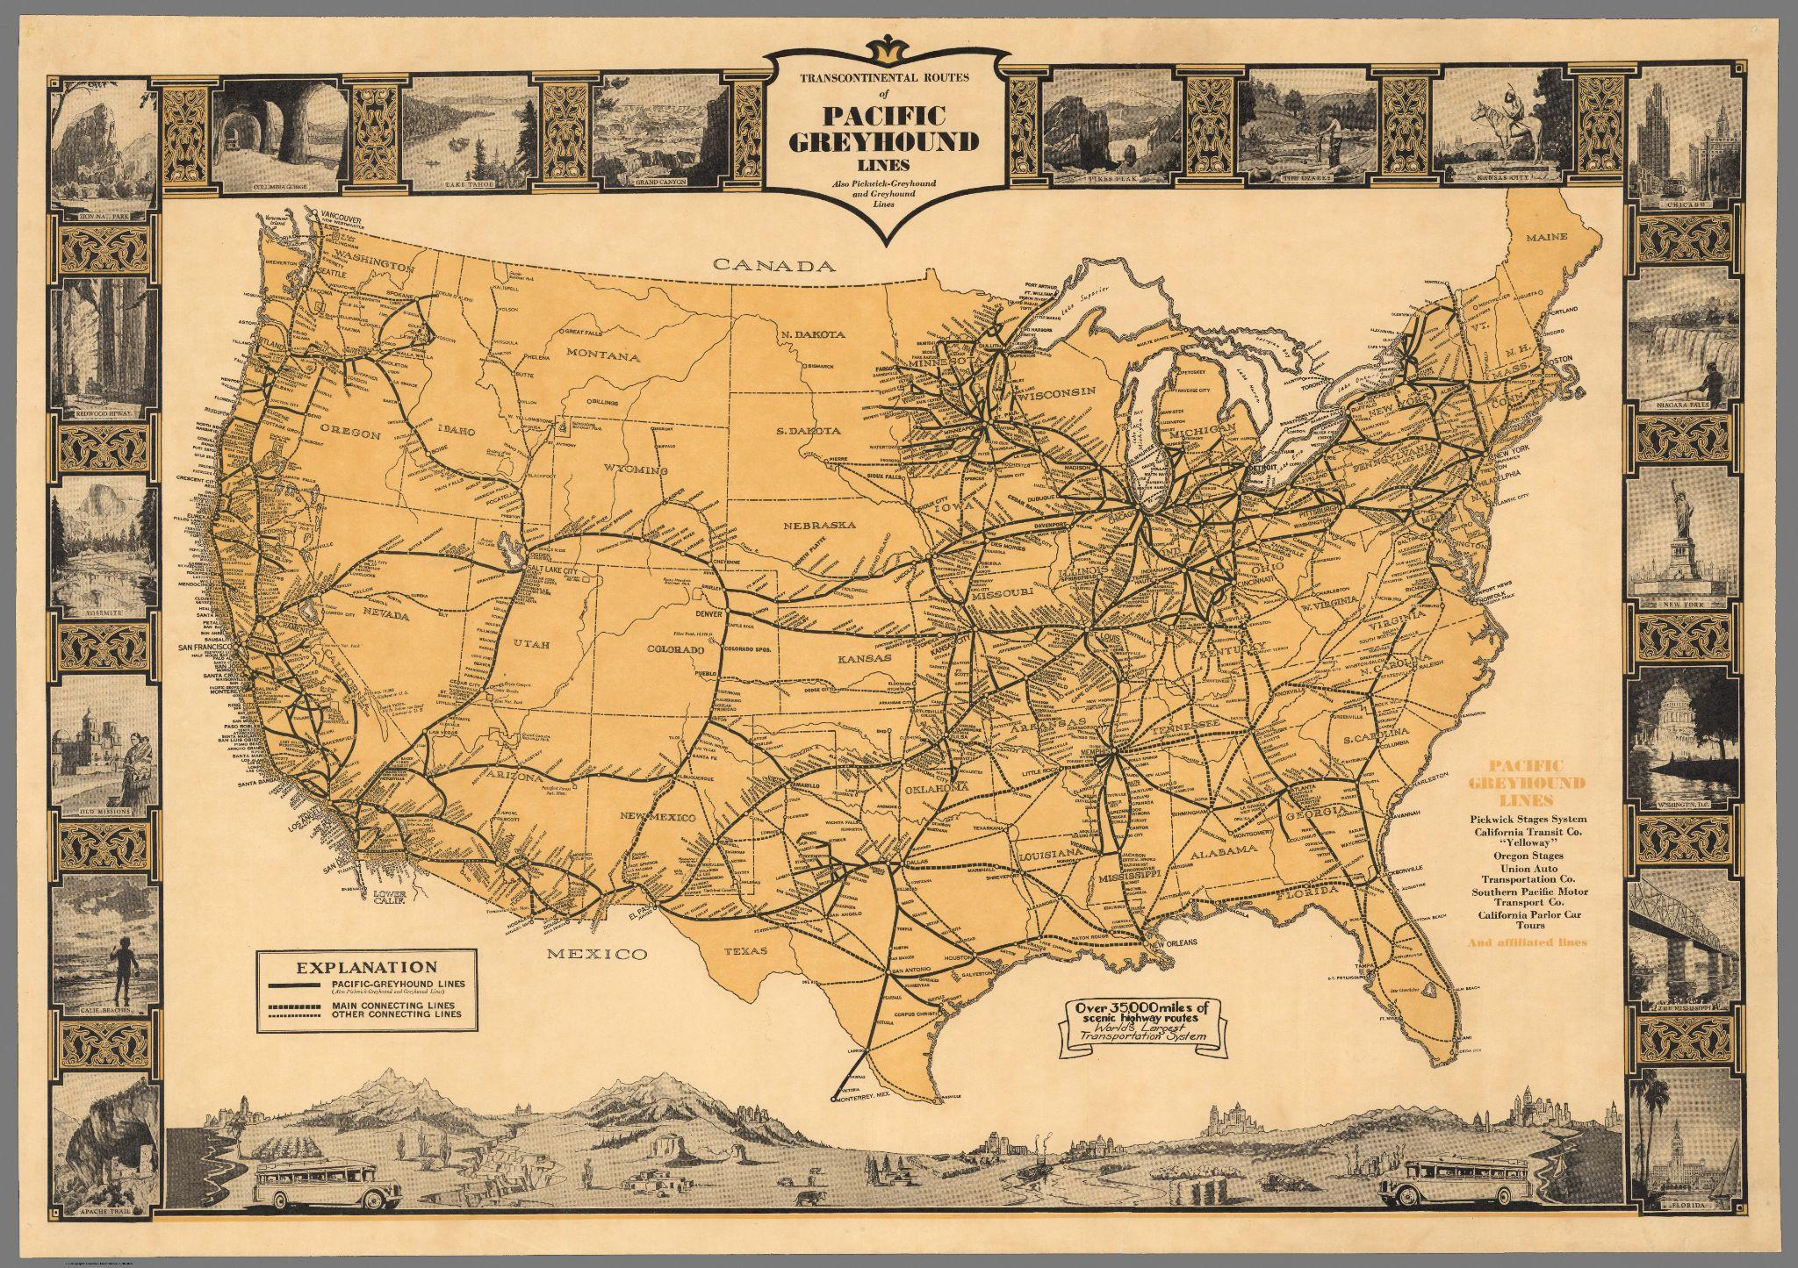
Exhibit 3
Notes:
African Americans seeking a new life outside of the South could more and more easily travel to anywhere in the United States via car, train, or, as shown on this map, bus. Greyhound bus routes map, 1935.
· What is this item?
· How is this item related to the theme of migration?
· What group, event, or issue is represented in this item?

Slide 22
Exhibit 4
Notes:
Image of a family upon their arrival to Chicago seeking a better life, 1922.
· What do you see in this image?
· What are the people in this image doing?
· Where do you think the image was taken?
· What questions do you have about this image?

Slide 23
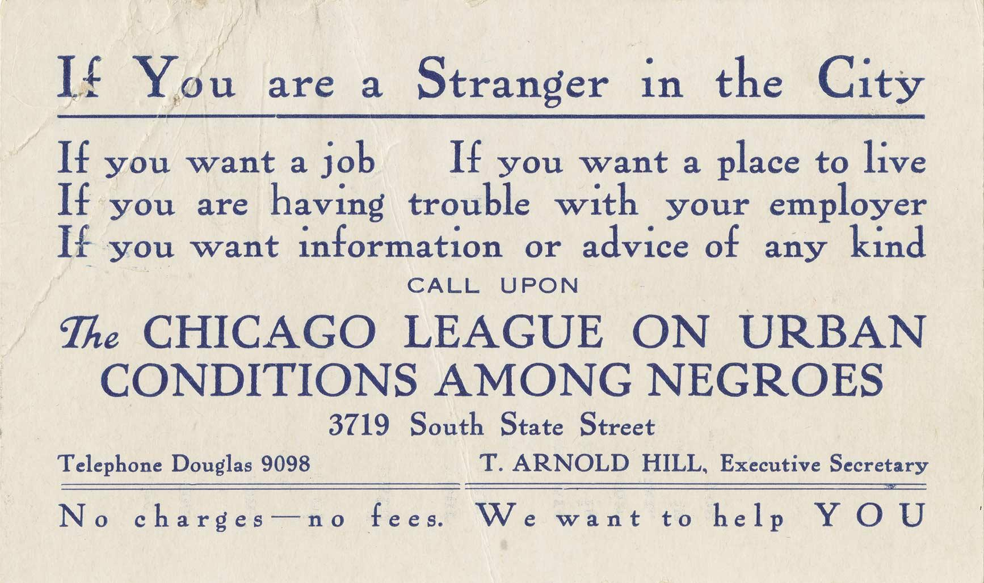
Exhibit 5
(Front)
Notes:
A card designed to help guide new arrivals from the South. Created by the organization known today as the Chicago Urban League, c. 1920.
· What is this item?
· What stands out to you about this item?
· What do you think the purpose of this item was?

Slide 24
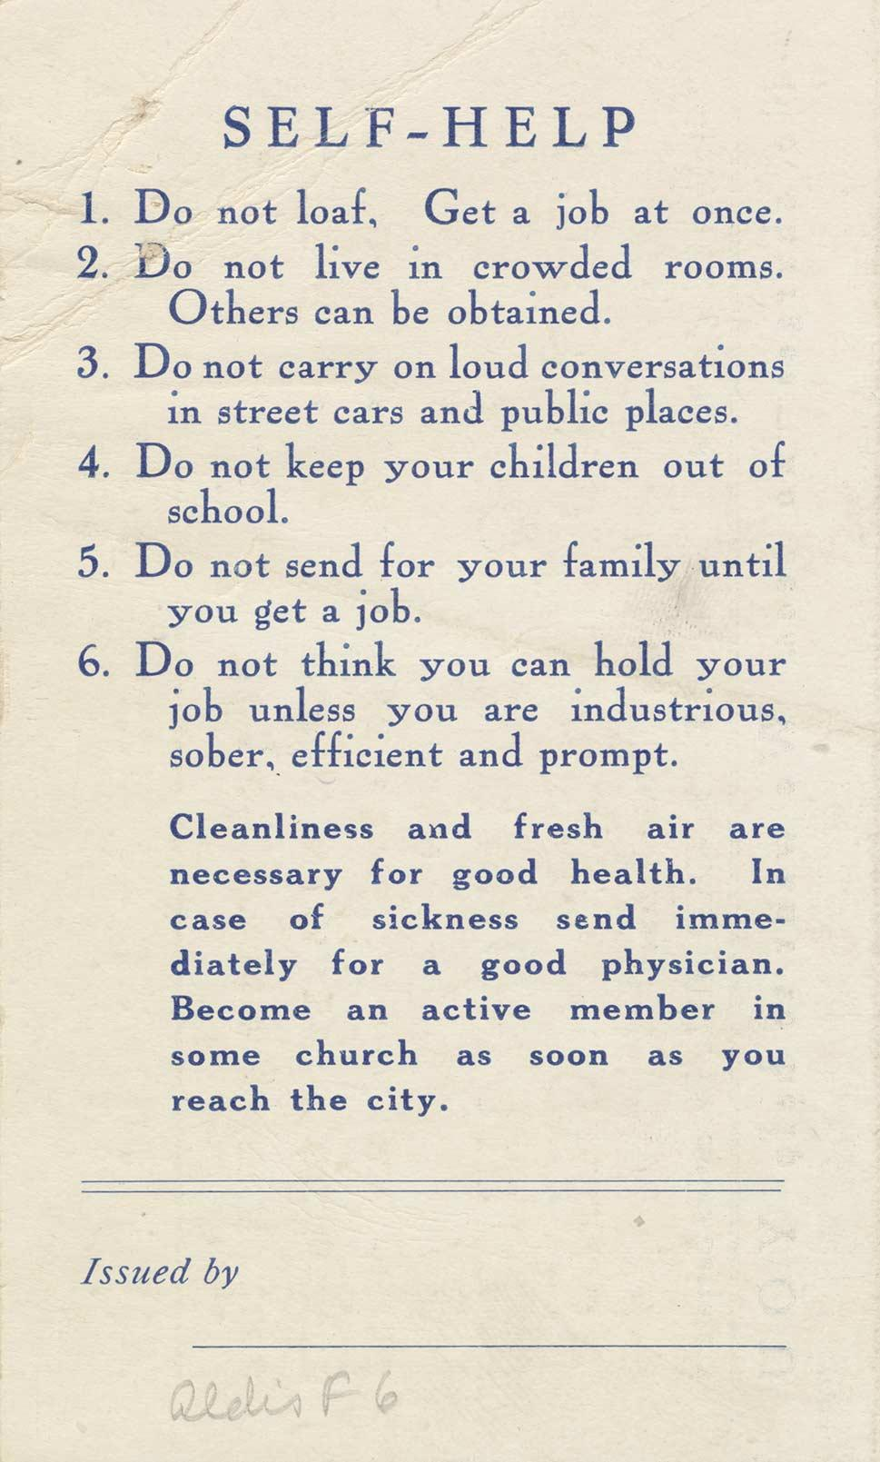
Exhibit 5
(Back)
Notes:
A card designed to help guide new arrivals from the South. Created by the organization known today as the Chicago Urban League, c. 1920.
· What is this item?
· What stands out to you about this item?
· What do you think the purpose of this item was?

Slide 25
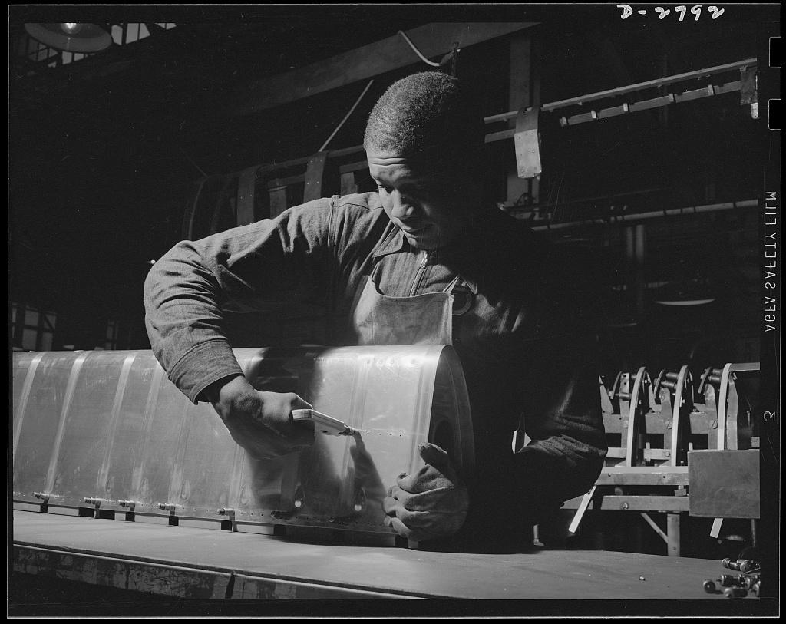
Exhibit 6
Notes:
Steel worker at the Briggs Manufacturing Company, Detroit, MI, 1942.
· What do you see in this image?
· Where was this image taken? What clues do you see?
· When you look at this image what other images come to mind?

Slide 26
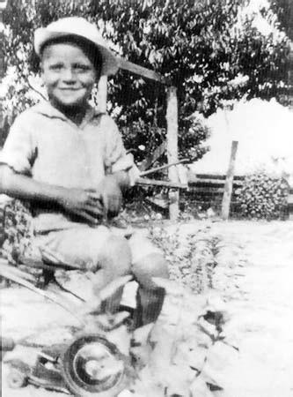
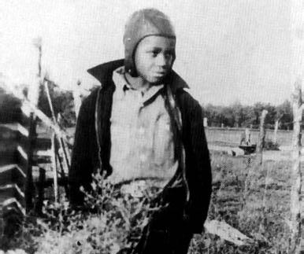
Exhibit 7
Notes:
Photographs of a young man, James Earl Jones, in Mississippi (left) and then after his family moved to Michigan (right).
· What do you see in these two images?
· What are some similarities and differences between the two images?
· When and where do you think these images were taken? What clues did you use?

Slide 27
What motivates people to migrate?
Notes:
Return to the Essential Question. Do students have any new thoughts after reviewing the primary sources?
*Ask students what impact the Great Migration might have had on those who left their homes to start over in a new place. This will help lead you into the next section, a case study of James Earl Jones.

Slide 28
Case Study
Notes:
.

Slide 29
James Earl Jones
Notes:
James Earl Jones was born in Arkabutla Township, Mississippi. His parents separated before his birth and he was raised by his grandparents on a farm that had been in the family since Reconstruction. When he was only five, the family moved north to a farm in rural Michigan, and the young boy found the adaptation so traumatic that he developed an incapacitating stutter. For years he refused to speak more than a few words at a time, even to his family. In school he pretended to be mute, and communicated only in writing. He began to express himself by writing poetry. James Earl Jones | Academy of Achievement

Slide 30

James Earl Jones

Slide 31
Conclusion
Notes:
.

Slide 32
What motivates people to migrate?
Notes:
End the lesson by asking students to reflect on what they’ve learned about the Great Migration. First, review the Essential Question.
Next, invite them to consider and reflect on some of the following questions:
How did the Great Migration shape the life of James Earl Jones and countless other African Americans?
James Earl Jones describes the train ride as a trauma for him. Why do you think his grandparents made him go through that? Was it worth it?
Do you think everyone thought of the move as traumatic? What are some other feelings people might have had about the move?
What are some of the factors individuals would consider when deciding whether to stay in the south or leave?
How would you feel if you had to leave your life behind to start fresh? What factors would make it necessary or desirable for you to do so?
Can you draw any parallels between the Great Migration and other migration movements in different parts of the world?

